Slide 1
Chapter 9 E-Commerce Security and Fraud Protection

Slide 2
LEARNING OBJECTIVES
Understand the importance and scope of the security of information systems for EC.
Describe the major concepts and terminology of EC security.
Learn about the major EC security threats, vulnerabilities, and risks.
Understand phishing and its relationship to financial crimes.
Describe the information assurance security principles.

Slide 3
LEARNING OBJECTIVES
Identify and assess major technologies and methods for securing EC communications.
Describe the major technologies for protection of EC networks.
Describe various types of controls and special defense mechanisms.
Describe the role of business continuity and disaster recovery planning.
Discuss EC security enterprise-wide implementation issues.
Understand why it is not possible to stop computer crimes.

Slide 4
THE INFORMATION SECURITY PROBLEM
WHAT IS EC SECURITY?
Computer security refers to the protection of data, networks, computer programs, computer power, and other elements of computerized information systems
The Status of Computer Security in the United States – no actual & real impact data to prove because not everyone and companies reported their security breaches. According to CSI (Computer Security Institute) only 27% of businesses reported to legal authorities about their computer intrusions.

Slide 5
THE INFORMATION SECURITY PROBLEM
CSI Computer Crime and Security Survey
Annual security survey of U.S. corporations, government agencies, financial and medical institutions, and universities conducted by the Computer Security Institute.
National Security Programs (US)
Cyber Security Preparedness and the National Cyber Alert System
US-CERT Operations
National Cyber Response Coordination Group
CyberCop Portal

Slide 6
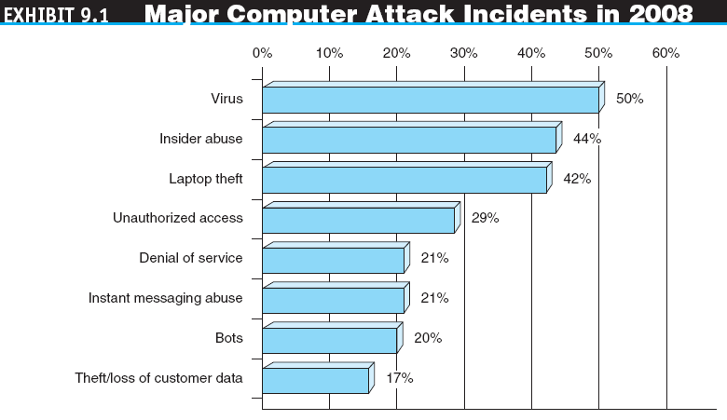

Slide 7
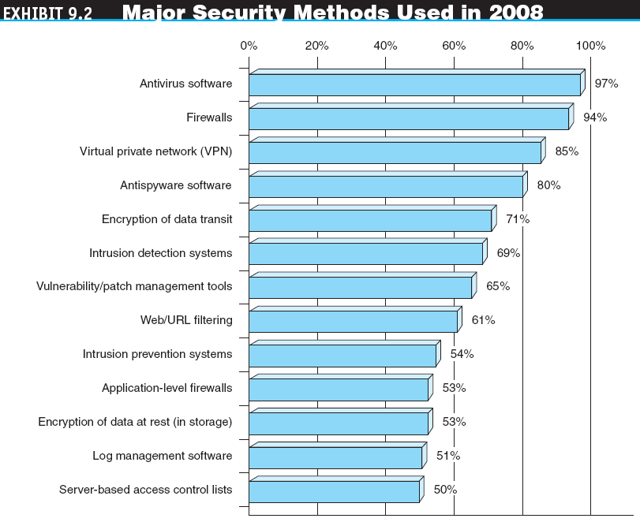

Slide 8
THE INFORMATION SECURITY PROBLEM
THE DRIVERS OF EC SECURITY PROBLEMS
The Internet’s Vulnerable Design – inherently meant for efficient communication and LESS on security
domain name system (DNS)
Translates (converts) domain names to their numeric IP addresses.
IP address
An address that uniquely identifies each computer connected to a network or the Internet.
The Shift to Profit-Induced Crimes
Early days hackers only wanted to become famous, just for fun, and prove themselves their technical knowledge. They did not attack systems with intention to gain profit.
NOW….money-oriented to steal credit cards, account nos. email passwords etc..

Slide 9
THE INFORMATION SECURITY PROBLEM
Internet underground economy
E-markets for stolen information made up of thousands of Web sites that sell credit card numbers, social security numbers, other data such as numbers of bank accounts, social network IDs, passwords, and much more.
keystroke logging (keylogging)
A method of capturing and recording user keystrokes.
The Dynamic Nature of EC Systems and the Role of Insiders
WHY IS E-COMMERCE SECURITY STRATEGY NEEDED?
The Computer Security Dilemma

Slide 10
BASIC E-COMMERCE SECURITY ISSUES AND LANDSCAPE
THE SECURITY BASIC TERMINOLOGY
business continuity plan
A plan that keeps the business running after a disaster occurs. Each function in the business should have a valid recovery capability plan.
cybercrime
Intentional crimes carried out on the Internet.
exposure
The estimated cost, loss, or damage that can result if a threat exploits a vulnerability.
fraud
Any business activity that uses deceitful practices or devices to deprive another of property or other rights.

Slide 11
BASIC E-COMMERCE SECURITY ISSUES AND LANDSCAPE
malware (malicious software)
A generic term for malicious software.
phishing
A crimeware technique to steal the identity of a target company to get the identities of its customers.
risk
The probability that a vulnerability will be known and used.
social engineering
A type of nontechnical attack that uses some ruse (騙術) to trick users into revealing information or performing an action that compromises a computer or network.

Slide 12
BASIC E-COMMERCE SECURITY ISSUES AND LANDSCAPE
spam
The electronic equivalent of junk mail.
vulnerability
Weakness in software or other mechanism that threatens the confidentiality, integrity, or availability of an asset (recall the CIA model). It can be directly used by a hacker to gain access to a system or network.
zombies
Computers infected with malware that are under the control of a spammer, hacker, or other criminal.

Slide 13
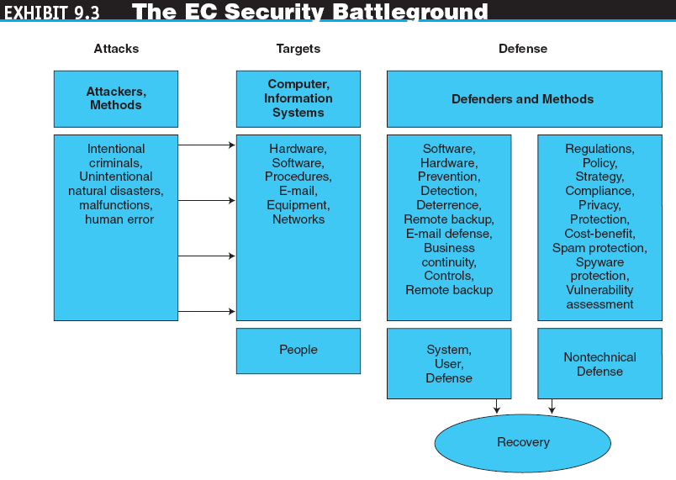

Slide 14
BASIC E-COMMERCE SECURITY ISSUES AND LANDSCAPE
Threats and Attacks: Unintentional and Intentional
Unintentional Threats
Human error
Environmental hazards
Malfunctions in the computer system
Intentional Attacks and Crimes

Slide 15
BASIC E-COMMERCE SECURITY ISSUES AND LANDSCAPE
Criminals and Social Engineering
cybercriminal
A person who intentionally carries out crimes over the Internet.
hacker
Someone who gains unauthorized access to a computer system.
cracker
A malicious hacker, such as Maxwell’s case causing damages on one US Hospital, who may represent a serious problem for a corporation.

Slide 16
BASIC E-COMMERCE SECURITY ISSUES AND LANDSCAPE
EC Security Requirements to protect EC transactions
Authentication
Process to verify (assure) the real identity of an individual, computer, computer program, or EC Web site. (e.g. userid/password, second password, challenge-response codes, personal security questions )
Authorization
Process of determining what the authenticated entity is allowed to access and what operations it is allowed to perform.
Auditing (records of what was accessed, when and who)
Availability
Non-repudiation – use digital signature or certificate
Assurance that online customers or trading partners cannot falsely deny (repudiate) their purchase or transaction.

Slide 17
BASIC E-COMMERCE SECURITY ISSUES AND LANDSCAPE
THE DEFENSE: DEFENDERS AND THEIR STRATEGY
EC Security Strategy
A strategy that views EC security as the process of preventing and detecting unauthorized use of the organization’s brand, identity, Web site, e-mail, information, or other asset and attempts to defraud the organization, its customers, and employees.

Slide 18
BASIC E-COMMERCE SECURITY ISSUES AND LANDSCAPE
deterring measures
Actions that will make criminals abandon their idea of attacking a specific system (e.g., the possibility of losing a job for insiders).
prevention measures
Ways to help stop unauthorized users (also known as “intruders”) from accessing any part of the EC system.
detection measures
Ways to determine whether intruders attempted to break into the EC system, whether they were successful, and what they may have done.

Slide 19
BASIC E-COMMERCE SECURITY ISSUES AND LANDSCAPE
Information Assurance (IA) : major goal of having EC Security
IA is the protection of information systems against unauthorized access to or modification of information whether in storage, processing, or transit, and against the denial of service to authorized users, including those measures necessary to detect, document, and counter such threats.
Defense Methods and Technologies (e.g. encryption)
Recovery

Slide 20
TECHNICAL ATTACK METHODS
TECHNICAL AND NONTECHNICAL ATTACKS: AN OVERVIEW
Software and systems knowledge are used to perpetrate technical attacks (computer virus)
Nontechnical attacks are those in which a perpetrator uses some form of deception or persuasion to trick people into revealing information or performing actions that can compromise the security of a network (email spams, social engineering, phishing)

Slide 21
TECHNICAL ATTACK METHODS
MALICIOUS CODE
virus
A piece of software code that inserts itself into a host, including the operating systems, in order to propagate; it requires that its host program be run to activate it.
worm
A software program that runs independently (without human intervention), consuming the resources of its host in order to maintain itself, that is capable of propagating a complete working version of itself onto another machine.

Slide 22
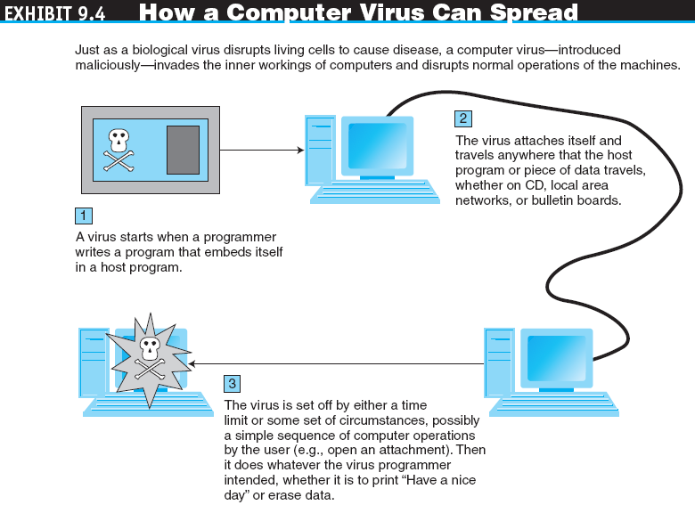

Slide 23
TECHNICAL ATTACK METHODS
macro virus (macro worm)
A macro virus or macro worm is executed when the application object that contains the macro is opened or a particular procedure is executed.
Trojan horse
A program that appears to have a useful function but that contains a hidden function that presents a security risk.
banking Trojan
A Trojan that comes to life when computer owners visit one of a number of online banking or e-commerce sites.

Slide 24
TECHNICAL ATTACK METHODS
denial of service (DoS) attack
An attack on a Web site in which an attacker uses specialized software to send a flood of data packets to the target computer with the aim of overloading its resources.
Web Server and Web Page Hijacking (e.g. search engine re-direct technique)
botnet
A huge number (e.g., hundreds of thousands) of hijacked Internet computers (robots or bot)) that have been set up to forward traffic, including spam and viruses, to other computers on the Internet.

Slide 25
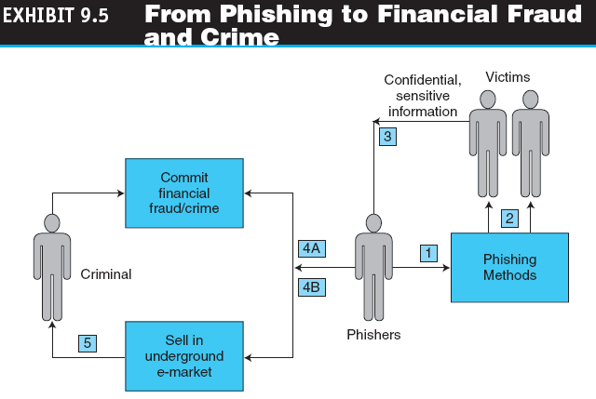

Slide 26
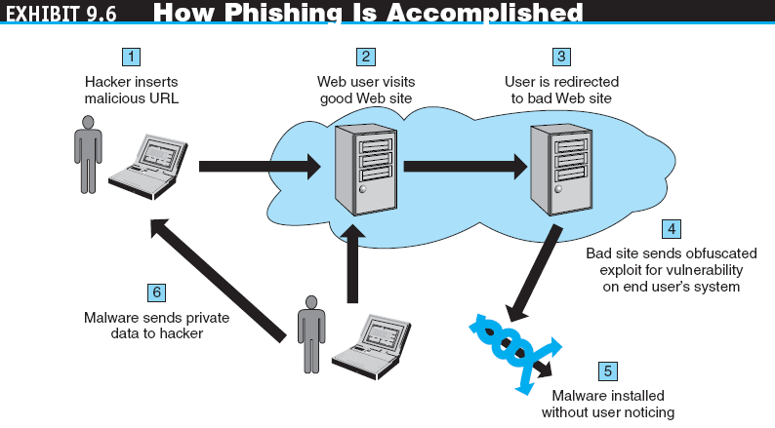

Slide 27
PHISHING, FINANCIAL FRAUD, AND SPAM
FRAUD ON THE INTERNET
Examples of Typical Online Fraud Attempts
identity theft
Fraud that involves stealing an identity of a person and then the use of that identity by someone pretending to be someone else in order to steal money or get other benefits.
Other Financial Fraud

Slide 28
PHISHING, FINANCIAL FRAUD, AND SPAM
SPAM AND SPYWARE ATTACKS
e-mail spam (junk emails)
A subset of spam that involves nearly identical messages sent to numerous recipients by e-mail.
spyware
Software that gathers user information over an Internet connection without the user’s knowledge.

Slide 29
PHISHING, FINANCIAL FRAUD, AND SPAM
search engine spam
Pages created deliberately to trick the search engine into offering inappropriate, redundant, or poor-quality search results.
spam site
Page that uses techniques that deliberately subvert a search engine’s algorithms to artificially inflate the page’s rankings.
splog
Short for spam blog. A site created solely for marketing purposes.

Slide 30
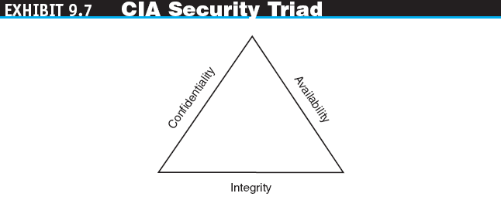
THE INFORMATION ASSURANCE MODEL AND DEFENSE STRATEGY
CIA security triad (CIA triad 三角) model
Three security concepts important to information on the Internet: Confidentiality, Integrity, and Availability.

Slide 31
THE INFORMATION ASSURANCE MODEL AND DEFENSE STRATEGY
Confidentiality
Assurance of data privacy and accuracy. Keeping private or sensitive information from being disclosed to unauthorized individuals, entities, or processes.
Integrity
Assurance that stored data has not been modified without authorization; a message that was sent is the same message as that which was received.
Availability
Assurance that access to data, the Web site, or other EC data service is timely, available, reliable, and restricted to authorized users.

Slide 32
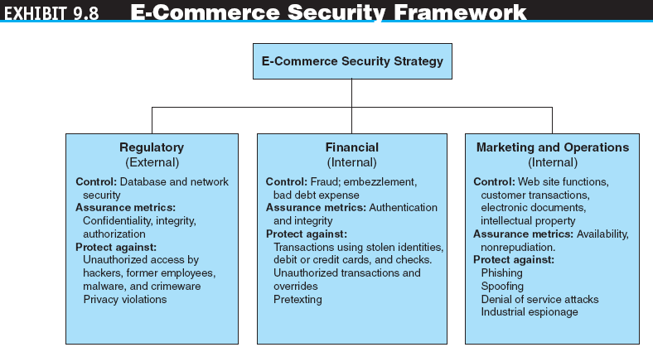

Slide 33
THE INFORMATION ASSURANCE MODEL AND DEFENSE STRATEGY
In summary….. EC Security Strategy
A strategy that views EC security as the process of preventing and detecting unauthorized use of the organization’s brand, identity, Web site, e-mail, information, or other asset and attempts to defraud the organization, its customers, and employees.
Simply, it needs to cover 3 high level categories (refer previous slide-exhibit 9.8) of assurance and controls. i) Regulatory, ii) Financial, iii) Marketing and Operations
9-32
Notes:
32

Slide 34
THE INFORMATION ASSURANCE MODEL AND DEFENSE STRATEGY
EC SECURITY STRATEGY
Defense Objectives
Prevention and deterrence
Detection
Containment (contain the damage)
Recovery
Correction
Awareness and compliance
EC security programs
All the policies, procedures, control measures, documents, standards, hardware, software, training, and personnel that work together to protect information, the ability to conduct business, and other assets.
Copyright © 2011 Pearson Education, Inc. Publishing as Prentice Hall
9-33
Notes:
33

Slide 35
THE DEFENSE I: ACCESS CONTROL, ENCRYPTION, AND PKI
access control
Mechanism that determines who can legitimately use a network resource.
Authentication and Passwords
biometric control
An automated method for verifying the identity of a person based on physical or behavioral characteristics. (e.g. finger-print, voice, retinal-eye scan, signature)
biometric systems
Authentication systems that identify a person by measurement of a biological characteristic, such as fingerprints, Iris (eye) patterns, facial features, or voice.

Slide 36
THE DEFENSE I: ACCESS CONTROL, ENCRYPTION, AND PKI
Technology Comparison – Biometric Recognition
Method | Pattern | Error rate (FAR) | Security Level | Applications
Iris (eye) | Iris pattern | 1/1.2M | High | High security areas - airport
Finger print | Finger print | 1/1000 | Medium | general
Hand Shape | Size, length and thickness of hand | 1/700 | Low | Low security facilities
Facial recognition | Outline, shape and distribution of eyes and nose | 1/100 | Low | Low security facilities
Signature | Shape of letters, writing order, pressure | 1/100 | Low | Low security facilities
Voice | Voice characteristics | 1/30 | Low | Telephone services
9-35
Notes:
35

Slide 37
THE DEFENSE I: ACCESS CONTROL, ENCRYPTION, AND PKI
Factors to consider when selecting biometric technology:
Ease of use
Intrinsic error effects (e.g. human changed due to aging)
Device accuracy
User acceptance
Cost to benefit
Stability/maturity of technology
Required security level

Slide 38
THE DEFENSE I: ACCESS CONTROL, ENCRYPTION, AND PKI
Two key methods to measure biometric accuracy:
a) False Acceptance Rate (FAR)
the percentage of imposters incorrectly matched to a genuine and valid user’s biometric template
b) False Rejection Rate (FRR)
the percentage of incorrectly rejected genuine and valid users
Copyright © 2011 Pearson Education, Inc. Publishing as Prentice Hall
9-37
Notes:
37

Slide 39
THE DEFENSE I: ACCESS CONTROL, ENCRYPTION, AND PKI
ENCRYPTION AND THE ONE-KEY (SYMMETRIC) SYSTEM
encryption
The process of scrambling (encrypting) a message in such a way that it is difficult, expensive, or time-consuming for an unauthorized person to unscramble (decrypt) it.
plaintext
An unencrypted message in human-readable form.
ciphertext
A plaintext message after it has been encrypted into a machine-readable form.
encryption algorithm
The mathematical formula used to encrypt the plaintext into the ciphertext, and vice versa.
Copyright © 2011 Pearson Education, Inc. Publishing as Prentice Hall
9-38
Notes:
38

Slide 40
THE DEFENSE I: ACCESS CONTROL, ENCRYPTION, AND PKI
key (key value)
The secret code used to encrypt and decrypt a message.
key space
The large number of possible key values (keys) created by the algorithm to use when transforming the message.
symmetric (private) key encryption
An encryption system that uses the same key to encrypt and decrypt the message.
Data Encryption Standard (DES)
The standard symmetric encryption algorithm supported by the NIST and used by U.S. government agencies until October 2000.

Slide 41
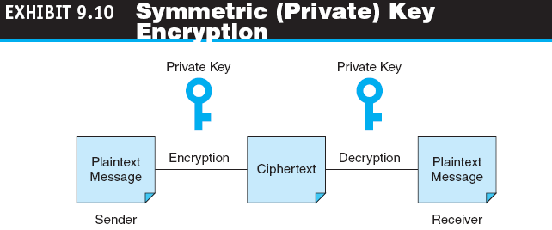
THE DEFENSE I: ACCESS CONTROL, ENCRYPTION, AND PKI
public key infrastructure (PKI)
A scheme for securing e-payments using public key encryption and various technical components.

Slide 42
THE DEFENSE I: ACCESS CONTROL, ENCRYPTION, AND PKI
public (asymmetric) key encryption
Method of encryption that uses a pair of matched keys—a public key to encrypt a message and a private key to decrypt it, or vice versa. (e.g. RSA encryption algorithm)
public key
Encryption code that is publicly available to anyone.
private key
Encryption code that is known only to its owner.

Slide 43
THE DEFENSE I: ACCESS CONTROL, ENCRYPTION, AND PKI
The PKI Process
digital signature or digital certificate
Validates the sender and time stamp of a transaction so it cannot be later claimed that the transaction was unauthorized or invalid.
hash
A mathematical computation that is applied to a message, using a private key, to encrypt the message.
message digest (MD)
A summary of a message, converted into a string of digits after the hash has been applied.
digital envelope
The combination of the encrypted original message and the digital signature, using the recipient’s public key.

Slide 44
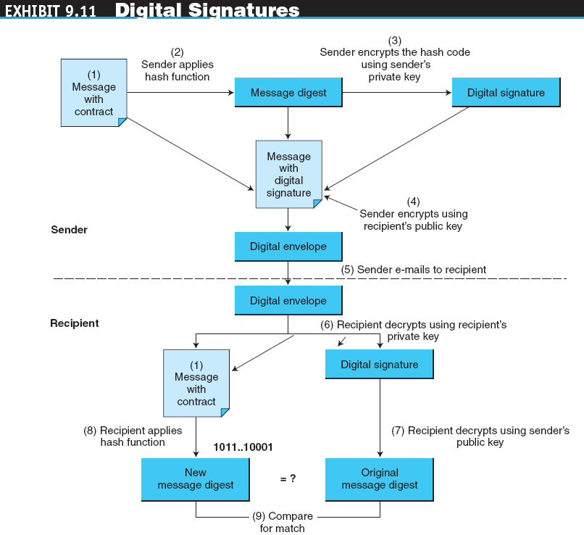

Slide 45
THE DEFENSE I: ACCESS CONTROL, ENCRYPTION, AND PKI
certificate authorities (CAs)
Third parties that issue digital certificates. (VeriSign, HK Post Office?)
Secure Socket Layer (SSL) – invented by Netscape
Protocol that utilizes standard certificates for authentication and data encryption (eg. credit card details) to ensure privacy or confidentiality.
Transport Layer Security (TLS)
As of 1996, SSL renamed to TLS.

Slide 46
THE DEFENSE II: SECURING E-COMMERCE NETWORKS
firewall
A single point between two or more networks where all traffic must pass (choke point); the device authenticates, controls, and logs all traffic.
packet
Segment of data sent from one computer to another on a network.
personal firewall
A network node designed to protect an individual user’s desktop system from the public network by monitoring all the traffic that passes through the computer’s network interface card.

Slide 47
THE DEFENSE II: SECURING E-COMMERCE NETWORKS
virtual private network (VPN)
A network that uses the public Internet to carry information but remains private by using encryption to scramble the communications, authentication to ensure that information has not been tampered with, and access control to verify the identity of anyone using the network.
protocol tunneling
Method used to ensure confidentiality and integrity of data transmitted over the Internet by encrypting data packets, sending them in packets across the Internet, and decrypting them at the destination address.

Slide 48
THE DEFENSE II: SECURING E-COMMERCE NETWORKS
intrusion detection system (IDS)
A special category of software that can monitor activity across a network or on a host computer, watch for suspicious activity, and take automated action based on what it sees.
honeynet
A network of honeypots.
honeypot
Production system (e.g., firewalls, routers, Web servers, database servers) that looks like it does real work, but that acts as a decoy and is watched to study how network intrusions occur.
penetration test (pen test)
A method of evaluating the security of a computer system or a network by simulating an attack from a malicious source, (e.g., a cracker).

Slide 49
THE DEFENSE III: GENERAL CONTROLS AND OTHER DEFENSE MECHANISMS
general controls
Controls established to protect the system regardless of the specific application. For example, protecting hardware and controlling access to the data center are independent of the specific application.
application controls
Controls that are intended to protect specific applications.

Slide 50
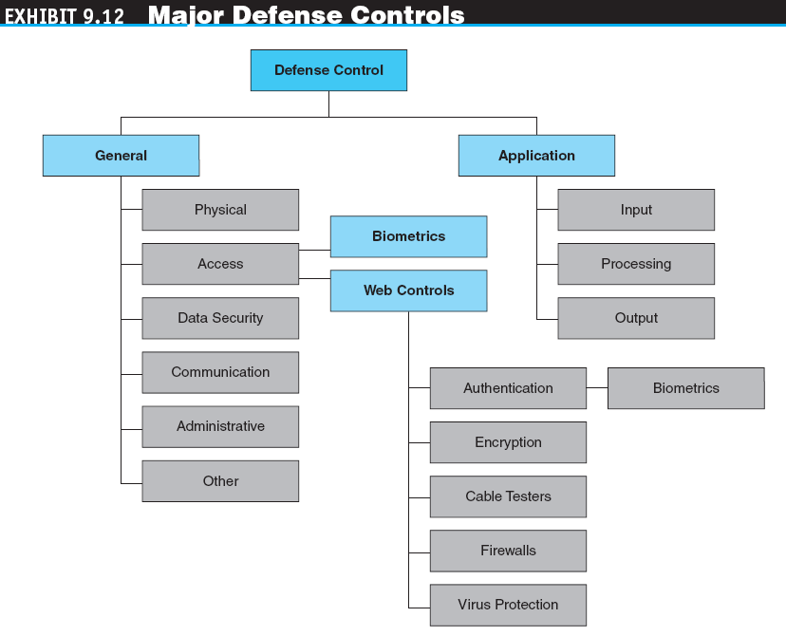

Slide 51
THE DEFENSE III: GENERAL CONTROLS AND OTHER DEFENSE MECHANISMS
APPLICATION CONTROLS
intelligent agents
Software applications that have some degree of reactivity, autonomy, and adaptability—as is needed in unpredictable attack situations. An agent is able to adapt itself based on changes occurring in its environment.
internal control environment
The work atmosphere that a company sets for its employees.

Slide 52
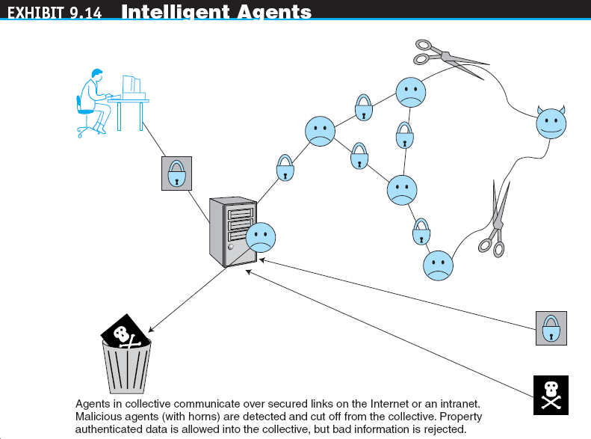

Slide 53
THE DEFENSE III: GENERAL CONTROLS AND OTHER DEFENSE MECHANISMS
PROTECTING AGAINST SPAM
Controlling the Assault of Non-Solicited Pornography and Marketing (CAN-SPAM) Act
Law that makes it a crime to send commercial e-mail messages with false or misleading message headers or misleading subject lines.
PROTECTING AGAINST POP-UP ADS
PROTECTION AGAINST PHISHING
PROTECTING AGAINST SPYWARE

Slide 54
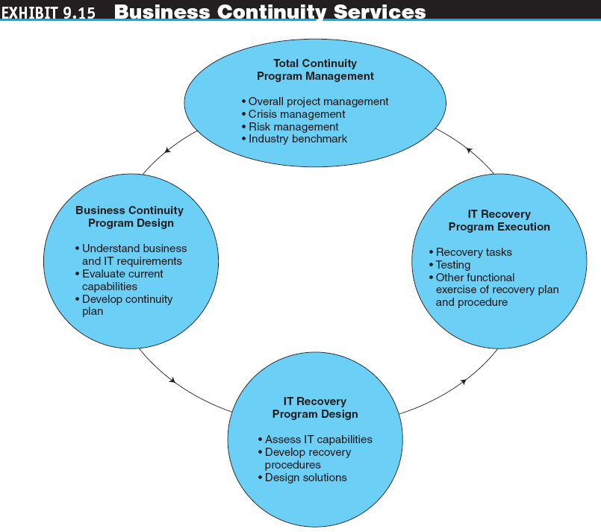

Slide 55
BUSINESS CONTINUITY, SECURITY AUDITING, AND RISK MANAGEMENT
BUSINESS CONTINUITY AND DISASTER RECOVERY PLANNING
disaster avoidance
An approach oriented toward prevention. The idea is to minimize the chance of avoidable disasters (such as fire or other human-caused threats).
RISK-MANAGEMENT AND COST-BENEFIT ANALYSIS
Risk-Management Analysis
Ethical Issues

Slide 56
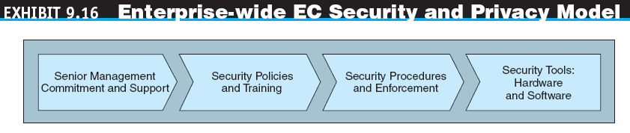
IMPLEMENTING ENTERPRISE-WIDE E-COMMERCE SECURITY
SENIOR MANAGEMENT COMMITMENT AND SUPPORT
EC SECURITY POLICIES AND TRAINING
acceptable use policy (AUP)
Policy that informs users of their responsibilities when using company networks, wireless devices, customer data, and so forth.

Slide 57
IMPLEMENTING ENTERPRISE-WIDE E-COMMERCE SECURITY
EC SECURITY PROCEDURES AND ENFORCEMENT
business impact analysis (BIA)
An exercise that determines the impact of losing the support of an EC resource to an organization and establishes the escalation of that loss over time, identifies the minimum resources needed to recover, and prioritizes the recovery of processes and supporting systems.
INDUSTRY STANDARDS FOR CREDIT CARD PROTECTION (PCI DSS)

Slide 58
IMPLEMENTING ENTERPRISE-WIDE E-COMMERCE SECURITY
WHY IS IT DIFFICULT TO STOP INTERNET CRIME?
Making Shopping Inconvenient
Shoppers’ Negligence
Ignoring EC Security Best Practices
Computing Technology Industry Association (CompTIA)
Nonprofit trade group providing information security research and best practices.
Design and Architecture Issues
standard of due care
Care that a company is reasonably expected to take based on the risks affecting its EC business and online transactions.

Slide 59
MANAGERIAL ISSUES
What is the EC security strategy of your company
Is the budget for IT security adequate?
What steps should businesses follow in establishing a security plan?
Should organizations be concerned with internal security threats?
What is the key to establishing strong
e-commerce security?

